Slide 1

Blood Bank Management System
COMP 520 - Advanced Database Systems
By:
Kumar Saurav Jha Uday Kiran Jadi

Slide 2
Introduction
Purpose:
A software solution designed to efficiently manage and streamline the operations of a blood bank.
Core Features:
  Donor/recipient registration & tracking.
  Real-time blood stock monitoring by blood type.
  History for blood donation and receiving(transfusions).

Slide 3





Technology Stack
Category | Technologies/Tools Used
Frontend and Backend | PHP
Database | MySQL
Server | Apache (via XAMPP Server)
Development Tools | Visual Studio Code, Dbeaver, phpMyAdmin, MySQL Workbench
Browser | Chrome.

Slide 4
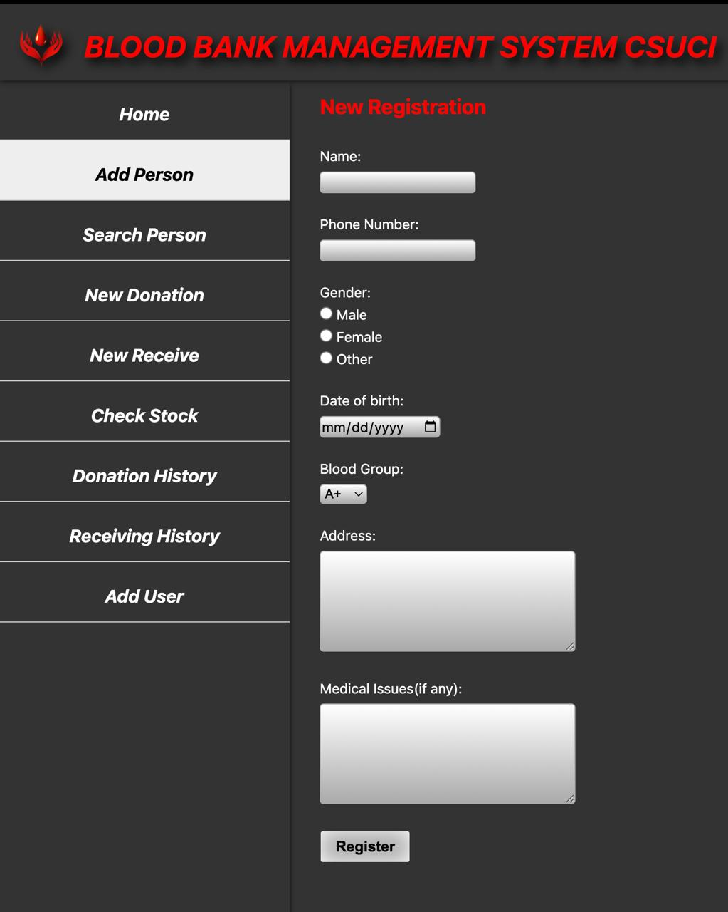
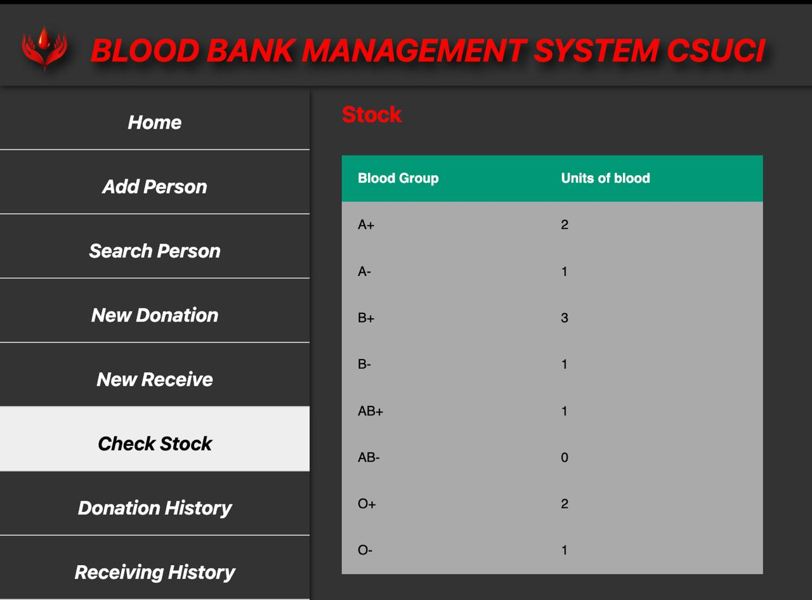
System Overview
Add Person Page
Registers new donors or blood receivers.
Search Person Page
Fetch details of a registered person.
Donation Page
Records blood donations.
Receive Page
Records blood transfusions.
Stock Page
Displays available blood stock by blood group.
Donation History Page
Shows donation records within a specified
time period.
Receive History Page
Shows blood transfusion records within a time frame.

Slide 5
Database Design(DDL)
person table
person_id(PK), person_name, person_phone, person_dob, person_address, person_gender, person_blood_group, person_med_issues
donation table
person_id(FK→person), donation_date, donation_time, donation_quantity
[Composite PK: person_id+donation_date+donation_time]
receive table
person_id(FK→person), received_date, received_time, received_quantity, received_hospital)
[Composite PK: person_id+received_date+received_time]
stock table
stock_blood_group(PK), stock_quantity
user table
username(PK), password

Slide 6
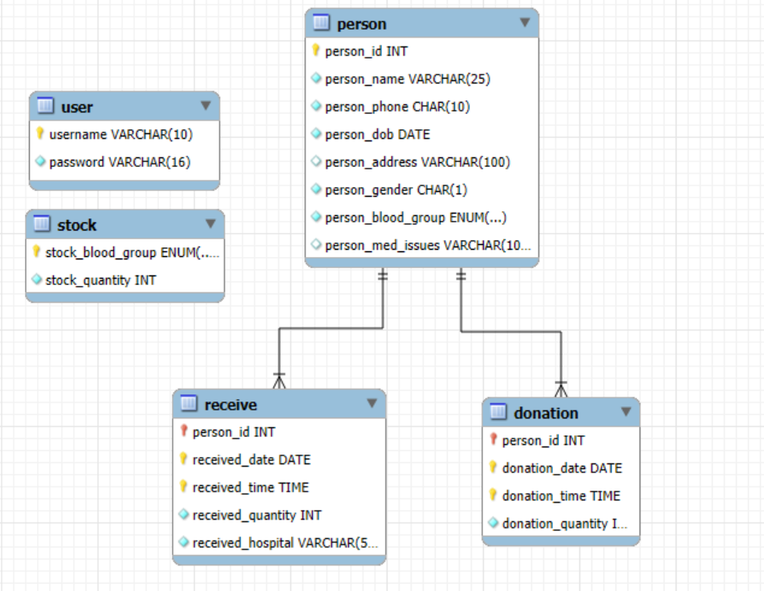
Entity Relationship Diagram

Slide 7
Views
View Name | Purpose | Key Fields | Filter/Logic
active_donors | Lists all blood donors | person_id, name, blood_group | Joined person and donation tables
blood_stock | Shows current inventory levels | blood_group, quantity | Sorted by stock quantity (DESC)
recent_donations | Last 30 days' donations | person_id, name, date, units | donation_date ≥ CURDATE() - 30 days
blood_receivers | Lists all blood recipients | person_id, name, blood_group | Joined person and receive tables
donor_blood_groups | Donor count by blood type | blood_group, donor_count | Grouped by person_blood_group

Slide 8
Stored Procedures
Procedure | Purpose | Parameters
AddPerson | Registers a new donor/recipient with personal details and blood type. | Name, phone, DOB, gender, blood group
RecordDonation | Logs a blood donation event with timestamp and quantity. | Person ID, quantity
RecordReceival | Records a blood transfusion with hospital details and quantity. | Person ID, quantity, hospital
UpdateStock | Adjusts inventory levels for a specific blood type. | Blood group, quantity
GetPerson | Retrieves complete profile data for a specified person. | Person ID
CountDonations | Calculates total donations made by a donor. | Person ID
GetStock | Displays current blood inventory levels sorted by quantity. | None
GetMonthlyDonations | Aggregates donation statistics by month for a given year. | Year (optional)
GetRecentDonations | Lists donations within a customizable time window. | Days
DeletePerson | Removes a person record and associated data. | Person ID
GetDonationSummary | Shows donation counts grouped by blood type. | None
GetBloodShortages | Identifies blood types below a specified threshold. | Minimum threshold

Slide 9
Triggers
Trigger | When Activated | Function | Example
update_stock_after_donation | AFTER INSERT | Auto-increases stock when blood is donated | 2 units of A+ → +2 to A+ inventory
validate_donation_amount | BEFORE INSERT | Ensures donations are valid | Blocks more units donation as unsafe
update_last_donation_date | AFTER INSERT | Records most recent donation date per donor | captures the most recent date of donor.

Slide 10
Challenges Faced
Data Inconsistencies
  No validation on fields(eg:same phone number different person name).
Real Time Tracking Gaps
  Delayed/inaccurate inventory updates leading to stockouts.
  No automated alerts for critical blood shortages.
Solutions Implemented
Automated Validation Systems
Implemented simple validations such as Person Name can't be numbers and Phone Number can't be characters.
Standardized Data Entry
Implemented ENUM types for blood groups (A+, B+, etc.)
Automated Alerts
warnings for critical blood levels (<5 units)

Slide 11
Future Enhancements
Include Validations(one account per phone number)
Smartphone Application
Implement a Dashboard
Conclusion
Improved Efficiency
  Automated processes reduced errors and manual work.
Better Inventory Control
  Real-time tracking and alerts for blood stock levels.
Secure & Scalable
  Protected donor data with role-based access for future expansion.

Slide 12
References
Silberschatz Korth and Sudharshan, Database System Concepts, 6th Edition, McGraw Hill, 2013.
Fundamentals of Database Systems, Ramez Elmasri and Shamkant B. Navathe, 7th Edition, 2017, Pearson.
Database management systems, Ramakrishna, and Gehrke, 3rd Edition, 2014, McGrawHill, 2013.
https://www.w3schools.com
http://geeksforgeeks.org/

Slide 13
DEMO

Slide 14
THANK YOU !!!

